Slide 1
Software Engineering (SR, Part-1)
Subject Code: INFO 3104
Book: Fundamentals of Software Engineering by Rajib Mall

Slide 2
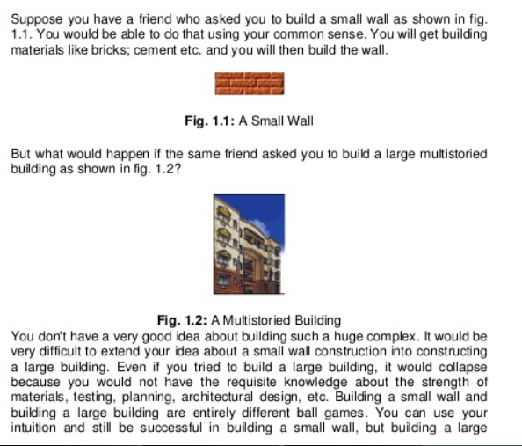
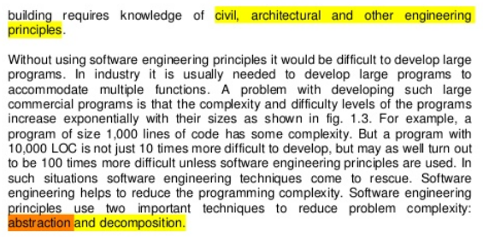
Scope & necessity of SE
Programs Vs. Complex commercial software

Slide 3
Programs versus Complex Software Products
Usually small in size
Author himself is sole user
Single developer
Lacks proper user interface
Lacks proper documentation
Ad hoc development.
Large
Large number of users
Team of developers
Well-designed interface
Well documented & user-manual prepared
Systematic development

Slide 4
Evolution of an Art into an Engineering Discipline
The early programmers used an exploratory (also called build and fix) style.
In the build and fix (exploratory) style, normally a `dirty' program is quickly developed.
The different imperfections that are subsequently noticed are fixed.

Slide 5
What is Wrong with the Exploratory Style? Cont…
Besides the exponential growth of effort, cost, and time with problem size:
Exploratory style usually results in un-maintainable code.
It becomes very difficult to use the exploratory style in a team development environment.
SE principles use two important techniques to reduce problem complexities: abstraction and decomposition

Slide 6
Abstraction
Simplify a problem by omitting unnecessary details.
Focus attention on only one aspect of the problem and ignore irrelevant details.
Suppose you are asked to develop an overall understanding of some country.
No one in his right mind would meet all the citizens of the country, visit every house, and examine every tree of the country, etc.
You would possibly refer to various types of maps for that country.
A map, in fact, is an abstract representation of a country.

Slide 7
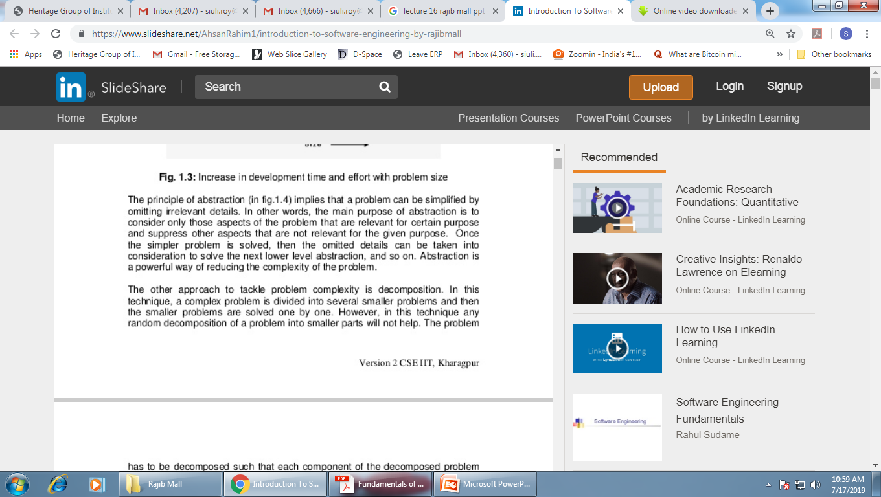
Abstraction
Political Map shows the state and national boundaries of a place. It also shows the location of cities, with respect to each other
Physical Map shows the physical features of a place or country, like rivers, mountains, forests and lakes
Climatic map shows the information about the climate of different areas.
Economic or resource maps show the different resources present in the area or economic activity prevalent.
Road map is the most widely used map which shows different roads, highways or railways present in the area.

Slide 8
Decomposition
A popular way to demonstrate the decomposition principle:
Try to break a bunch of sticks tied together versus breaking them individually.
Example use of decomposition principle:
You understand a book better when the contents are organized into independent chapters
Compared to when everything is mixed up.

Slide 9
Why Study Software Engineering?
To acquire skills to develop large programs.
Exponential growth in complexity and difficulty level with size.
The ad hoc approach breaks down when size of software increases.

Slide 10
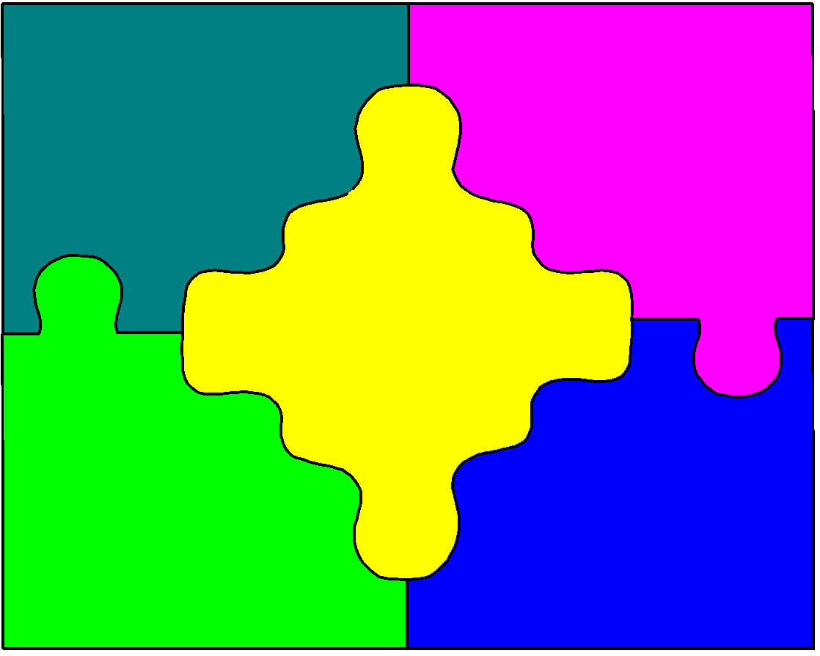
Why Study Software Engineering?
Ability to solve complex programming problems:
How to break large projects into smaller and manageable parts?
How to use abstraction?
Also learn techniques of:
Specification, design, user interface development, testing, project management, etc.
To acquire skills to be a better programmer:
Higher Productivity
Better Quality Programs

Slide 11
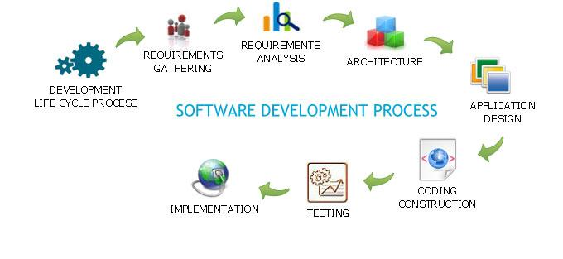

Software development process: Entities involved
Feasibility Study
Req. Analysis
Design
Coding
Testing
Maintenance

Slide 12
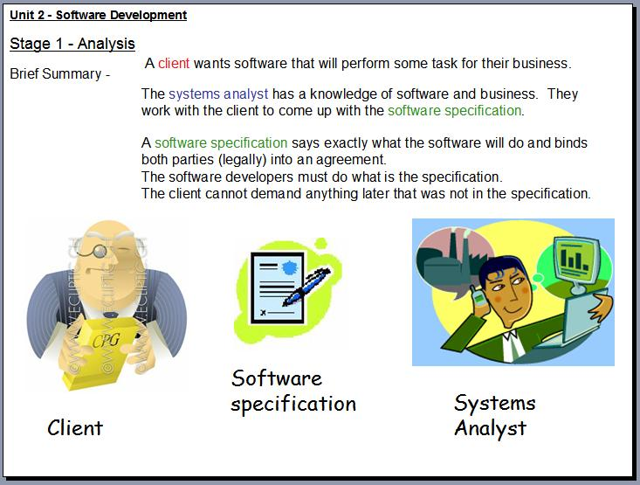

Slide 13
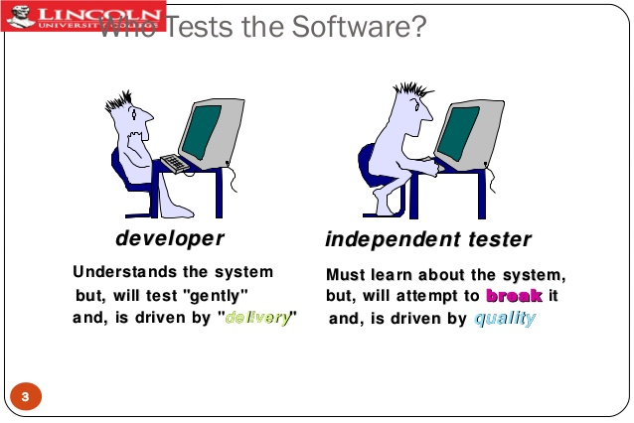

Slide 14
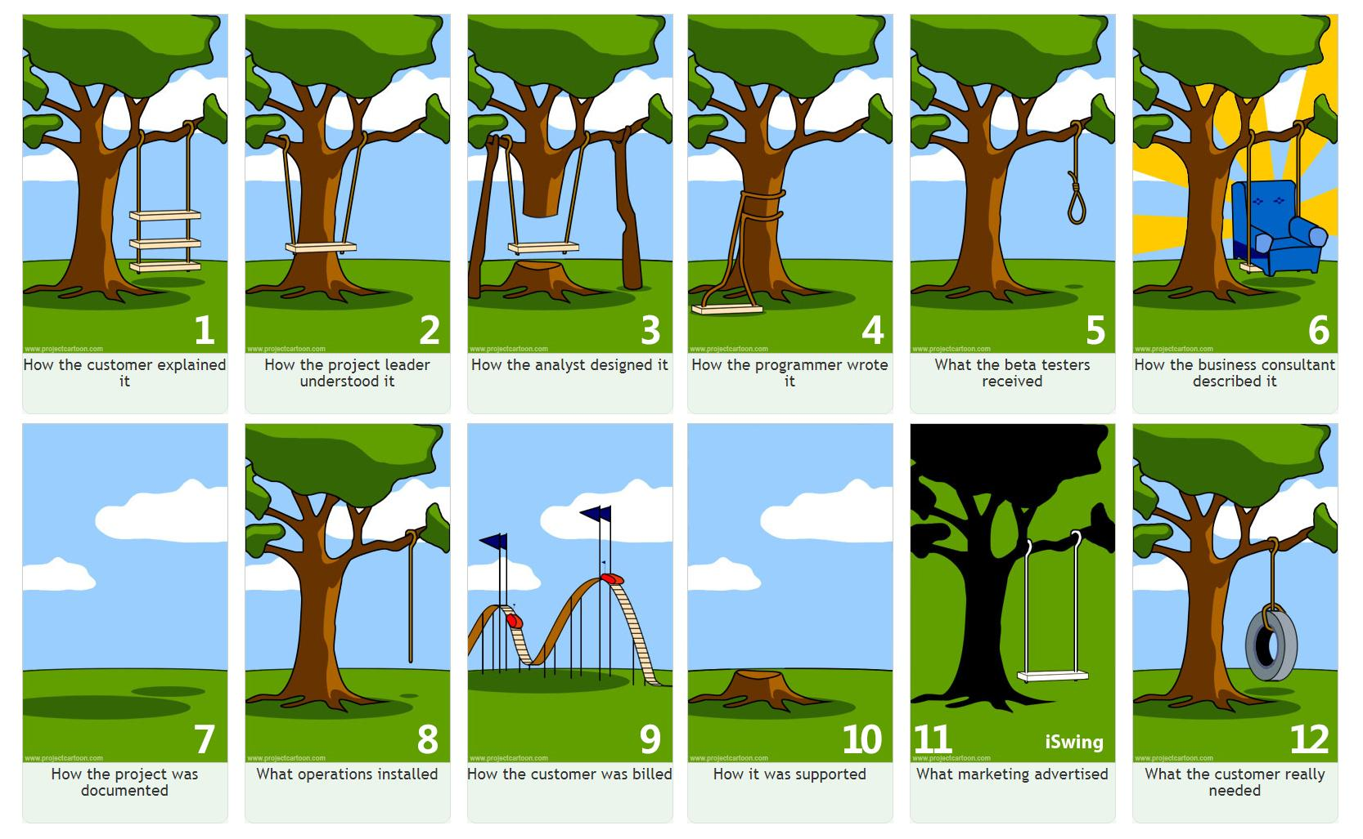
Project Management - A Tree Swing Story

Slide 15
Coding and Testing
Coding is undertaken once the design phase is complete and the design documents have been successfully reviewed.
In the coding phase, every module specified in the design document is coded and unit tested.
During unit testing, each module is tested in isolation from other modules.
That is, a module is tested independently as and when its coding is complete.
After all the modules of a system have been coded and unit tested,
the integration and system testing phase is undertaken.

Slide 16
Coding and Testing
Integration and testing of modules is carried out according to an integration plan.
The integration plan, according to which different modules are integrated together, usually envisages integration of modules through a number of steps.
During each integration step, a number of modules are added to the partially integrated system and the resultant system is tested.
The full product takes shape only after all the modules have been integrated together.
System testing is conducted on the full product.
During system testing, the product is tested against its requirements as recorded in the SRS document.

Slide 17
Coding and Testing
Testing is an important phase in software development and typically requires the maximum effort among all the development phases.
Moreover, testing involves a lot of creative thinking. Usually, testing of a professional software is carried out using a large number of test cases.
It is usually the case that many of the different test cases can be executed in parallel by different team members.
Therefore, to reduce the testing time, during the testing phase the largest manpower (compared to all other life cycle phases) is deployed.
Testing a software product is as much challenging as initial development activities such as specifications, design, and coding.

Slide 18
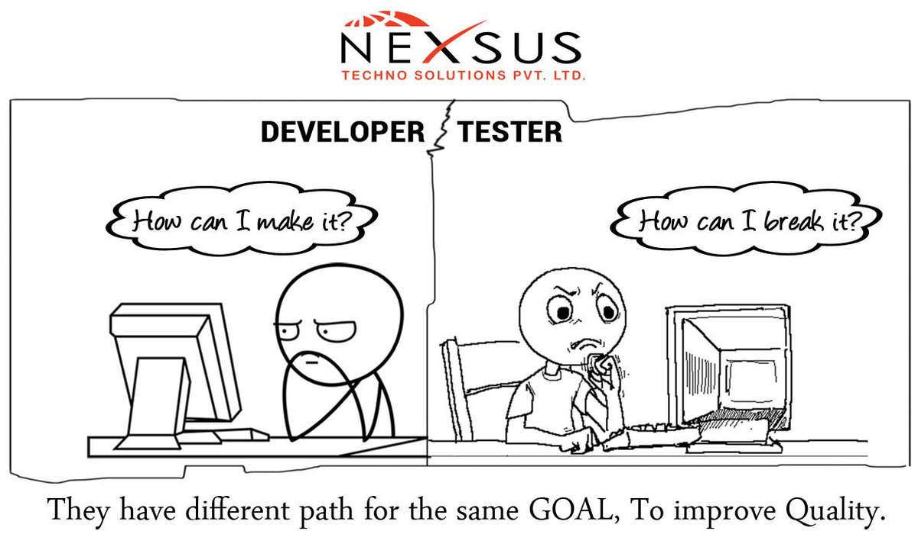
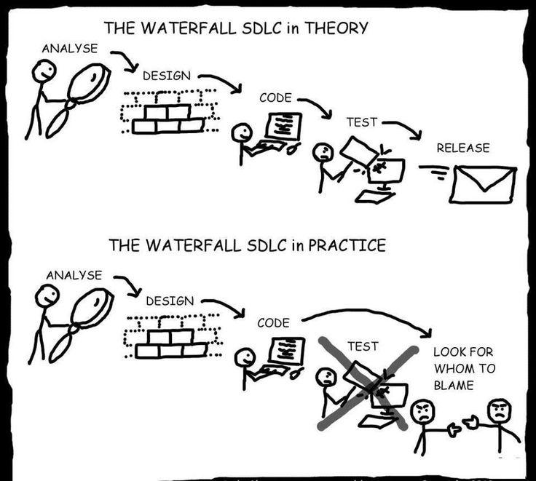
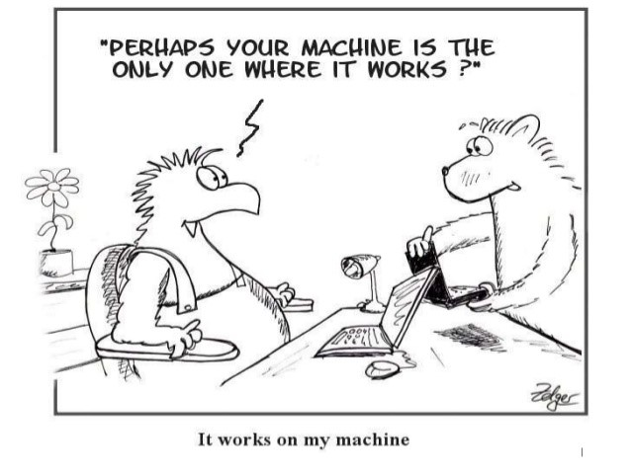
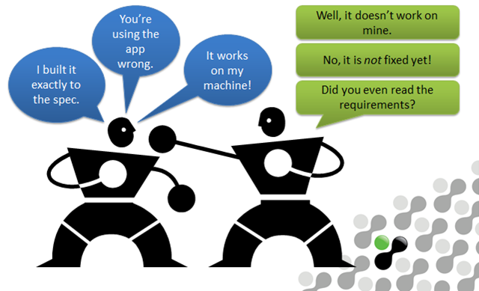
Tussle between Coder & Tester

Slide 19
Coding
The objective of the coding phase is to transform the design of a system into code in a high-level language, and then to unit test this code.
The input to the coding phase is the design document produced at the end of the design phase.
The detailed design is usually documented in the form of module specifications where
the data structures and algorithms for each module are specified.
During the coding phase, different modules identified in the design document are coded according to their respective module specifications.

Slide 20
Coding standard
Good software development organizations require their programmers to adhere to some well-defined and standard style of coding which is called their coding standard.
A coding standard lists several rules to be followed during coding, such as the way variables are to be named, the way the code is to be laid out, the error return conventions, etc.
These software development organizations formulate their own coding standards that suit them the most, and require their developers to follow the standards rigorously because of the significant business advantages it offers.
A coding standard gives a uniform appearance to the codes written by different engineers.
It facilitates code understanding and code reuse.
It promotes good programming practices.

Slide 21
Representative coding standards
Rules for limiting the use of globals:
These rules list what types of data can be declared global and what cannot.
Standard headers for different modules:
The header of different modules should have standard format and information for ease of understanding and maintenance.
Name of the module
Date on which the module was created
Author’s name
Modification history
Synopsis of the module. (small write-up about what the module does)
Different functions supported in the module, along with their input/output parameters
Global variables accessed/modified by the module

Slide 22
Representative coding standards
Naming conventions for global variables, local variables, and constant identifiers:
A popular naming convention is that variables are named using mixed case lettering.
Global variable names would always start with a capital letter (e.g., GlobalData) and local variable names start with small letters (e.g., localData).
Constant names should be formed using capital letters only (e.g., CONSTDATA).
Conventions regarding error return values and exception handling mechanisms:
The way error conditions are reported by different functions in a program should be standard within an organization.
For example, all functions while encountering an error condition should either return a 0 or 1 consistently, independent of which programmer has written the code.
This facilitates reuse and debugging.

Slide 23
Coding guidelines
Representative coding guidelines:
Do not use a coding style that is too clever or too difficult to understand:
C l e v e r coding can obscure meaning of the code and reduce code understandability; thereby making maintenance and debugging difficult and expensive.
Do not use an identifier for multiple purposes:
Programmers often use the same identifier to denote several temporary entities. For example, some programmers make use of a temporary loop variable for also computing and storing the final result.
Code should be well-documented:
As a rule of thumb, there should be at least one comment line on the average for every three/ four lines of code.
Length of any function should not exceed 10 source lines:
Do not use GO TO statements:
Use of GO TO statements makes a program unstructured. This makes the program very difficult to understand, debug, and maintain.

Slide 24
CODE REVIEW (starts after successful compilation of developed module)
Testing is an effective defect removal mechanism from executable code.
Review is a very effective technique to remove defects from source code.
Code review for a module is undertaken after the module successfully compiles.
That is, all the syntax errors have been eliminated from the module.
Code review is designed to detect logical, algorithmic, and programming errors.
In fact, review has been acknowledged to be more cost-effective in removing defects as compared to testing because
reviews directly detect errors.
On the other hand, testing only helps detect failures and significant effort is needed to locate the error during debugging

Slide 25
Code Review
Normally, the following two types of reviews are carried out on the code of a module:
Code walkthrough.
Code inspection.

Slide 26
Code walkthrough
Code walkthrough is an informal code analysis technique.
In this technique, a module is taken up for review after the module has been coded, successfully compiled, and all syntax errors have been eliminated.
A few members of the development team are given the code a couple of days before the walkthrough meeting.
Each member selects some test cases and simulates execution of the code by hand (i.e., traces the execution through different statements and functions of the code).
The members note down their findings of their walkthrough and discuss those in a walkthrough meeting where the coder of the module is present.

Slide 27
Guidelines of code walkthrough process
The team performing code walkthrough should not be either too big or too small.
Ideally, it should consist of between three to seven members.
Discussions should focus on discovery of errors and avoid deliberations on how to fix the discovered errors.
In order to foster co-operation and to avoid the feeling among the engineers that they are being watched and evaluated in the code walkthrough meetings, managers should not attend the walkthrough meetings.

Slide 28
Code Inspection
During code inspection, the code is examined for the presence of some common programming errors.
This is in contrast to the hand simulation of code execution carried out during code walkthroughs.
The inspection process has several beneficial side effects, other than finding errors.
The programmer usually receives feedback on
programming style,
choice of algorithm, and
programming techniques.
The other participants gain by being exposed to another programmer’s errors.

Slide 29
some classical programming errors checked during code inspection:
Use of un-initialised variables.
Non-terminating loops.
Incompatible assignments.
Array indices out of bounds.
Improper storage allocation and de-allocation.
Mismatch between actual and formal parameter in procedure calls.
Use of incorrect logical operators or incorrect precedence among operators.
Improper modification of loop variables.
Comparison of equality of floating point values.
Dangling reference caused when the referenced memory has not been allocated.

Slide 30
Clean Room Testing
Clean room testing was pioneered at IBM drawing analogy to the semiconductor fabrication units where defects are avoided by manufacturing in an ultra-clean atmosphere.
This type of testing relies heavily on walkthroughs, inspection, and formal verification.
The main problem with this approach is that testing effort is increased as walkthroughs, inspection, and verification are time consuming for detecting all simple errors.
Also testing-based error detection is efficient for detecting certain errors that escape manual inspection.

Slide 31
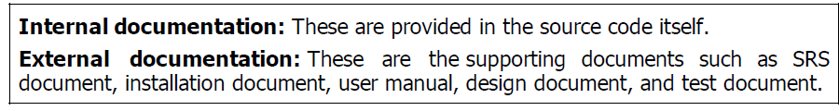
Software Documentation
When a software is developed, in addition to the executable files and the source code, several kinds of documents such as software requirements specification (SRS) document, design document, test document, installation manual, users’ manual, etc., are developed as part of the software engineering process.
Good documents
enhance understandability of code.
help the users to understand and effectively use the system.
help to effectively tackle the manpower turnover problem.
Even when an engineer leaves the organization, and a new engineer comes in, he can build up the required knowledge easily by referring to the documents.
helps the manager to effectively track the progress of the project.
The project manager would know that some measurable progress has been achieved, if the results of some pieces of work has been documented and the same has been reviewed.

Slide 32
Internal Documentation
Good software development organizations usually ensure good internal documentation by appropriately formulating their coding standards and coding guidelines
Internal documentation is the code comprehension features provided in the source code itself. The important types of internal documentation are the following:
Comments embedded in the source code.
a=10; /* a made 10 */ trivial comment
A good style of code commenting is to write to clarify certain non-obvious aspects of the working of the code, rather than cluttering the code with trivial comments.
Use of meaningful variable names.
Module and function headers.
Code indentation.
Code structuring (i.e., code decomposed into modules and functions).
Use of enumerated types.
Use of constant identifiers.
Use of user-defined data types.

Slide 33
External Documentation
An important feature that is required of any good external documentation is consistency of documentation with the code.
If the different documents are not consistent, a lot of confusion is created for somebody trying to understand the software.
All the documents developed for a product should be up-to-date and every change made to the code should be reflected in the relevant external documents.
Even if only a few documents are not up-to-date, they create inconsistency and lead to confusion.
Another important feature required for external documents is proper understandability by the category of users for whom the document is designed.
For achieving this, Gunning’s fog index is very useful.
software requirements specification (SRS) document,
design document,
test document,
installation manual,
users’ manual

Slide 34
Gunning’s fog index developed by Robert Gunning in 1952
It is a metric that has been designed to measure the readability of a document.
The computed metric value (fog index) of a document indicates the number of years of formal education that a person should have, in order to be able to comfortably understand that document.
if a certain document has a fog index of 12, anyone who has completed his 12th class would not have much difficulty in understanding that document.

Slide 35
Computation of Gunning’s fog index
Formula of Fog Index or Clarity Index:
Step 1:
Count the total number of words in the passage.
Step 2:
Count the number of sentences in the passage.
Step 3:
Count the average number of words in each sentence (by dividing the number of words by the number of sentences). For example, a 100-word passage comprising 10 sentences would have an average sentence length of 100/10 or 10 words).
Step 4:
Count the number of words having three syllables or more in the passage.
While calculating, do not add the following:
a. Words that are capitalized (such as proper nouns, e.g.. Bangalore, Minneapolis, Jawaharlal, etc.)
b. Words that are a combination of short easy words such as undertake, bookkeeping, anyone and multinational.
c. Verb forms whose number of syllables have increased by the addition of -ed, -es or -ing) such as credited.
Step 5:
Count the Fog index as
0.4 ((words/sentence) + 100 (complex words/words))
The final result determines the fog index or clarity index. Here, like golf, low scores are desirable and imply high clarity (or less foggy) English.

Slide 36
Computation of Gunning’s fog index
Observe that the fog index is computed as the sum of two different factors.
The first factor computes the average number of words per sentence
(total number of words in the document divided by the total number of sentences).
This factor therefore accounts for the common observation that long sentences are difficult to understand.
The second factor measures the percentage of complex words in the document.
For example, the word “sentences” has three syllables (“sen”, “ten”, and “ces”). Words having more than three syllables are complex words and presence of many such words hamper readability of a document.

Slide 37
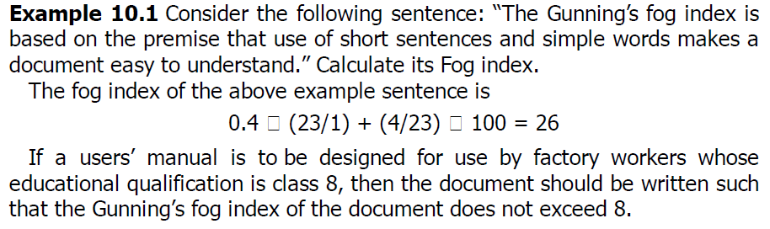
Calculation of Gunning’s fog index
.4((23/1)+ (4/23)*100) = 16
The Fog Index is a proven method of analyzing written material to see how easy it is to read and understand. The steps you can use to calculate the Fog Index are outlined below. The numbers in the right column are based on this paragraph. When using these steps to analyze your writing, choose a sample that contains at least one hundred words. The "ideal" Fog Index level is 7 or 8. A level above 12 indicates the writing sample is too hard for most people to read.

Slide 38
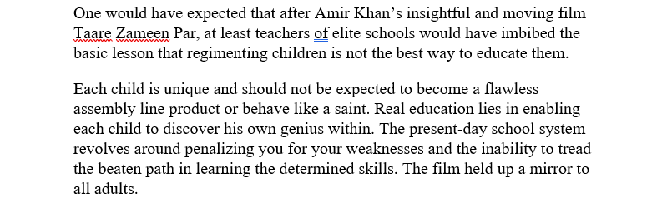
Exercise-1
Estimate the Fog Index of the following text.

Slide 39
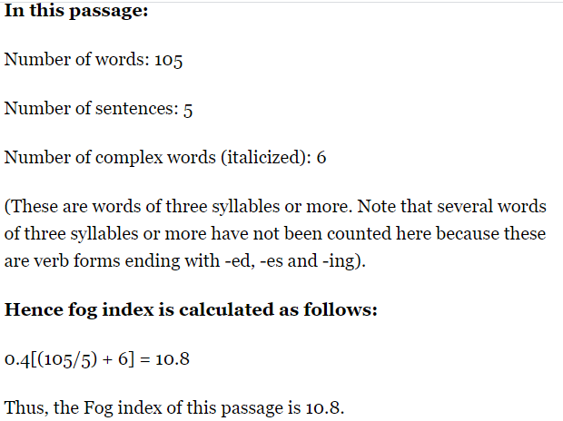
Answer

Slide 40
Exercise-2
Estimate the Fog Index of the following text.
The Fog Index is a proven method of analyzing written material to see how easy it is to read and understand. The steps you can use to calculate the Fog Index are outlined below. The numbers in the right column are based on this paragraph. When using these steps to analyze your writing, choose a sample that contains at least one hundred words. The "ideal" Fog Index level is 7 or 8. A level above 12 indicates the writing sample is too hard for most people to read.

Slide 41
Solution
1. | Count the number of words in the sample | 88
2. | Count the number of sentences | 6
3. | Count the number of big words (3 or more syllables) | 6
4. | Calculate the average sentence length. Divide the number of sentences into the number of words | 88/6 = 14
5. | Calculate the percentage of big words. Divide the number of words into the number of big words | 6/88 = 7%
6. | Add the average sentence length to the % of big words | 7 + 14 = 21
7. | Multiply the result by .4 | 21 x .4 =
 | Fog Index | 8.4

